Slide 1
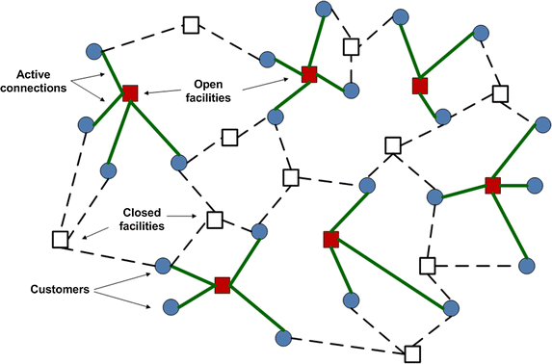
Mini Project-I
Facility Location Problem-Warehouse Location
09-05-2022
Under the guidance of,
Dr. B. Jayalakshmi
Asst. Professor
Computer Science & Engineering

Slide 2
Team Members
Dasari Rishikesh - 19BCS035
Shinde Rohit Sagar - 19BCS099
Suryawanshi Randheer Ajit - 19BCS104
Mane Param Dattatraya - 19BCS121

Slide 3
Literature Review
Facility location: Greedy and Local search algorithms by Anupam (CMU, USA)
A tabu search heuristic procedure for CFLP by Minghe Sun (University of Texas)
Metaheuristics for solving facility location optimization problem by ASTES journal
Efficient solution of large scale, single-source, capacitated plant location problem by the journal of OR society

Slide 4
What is FLP ?
The Facility Location Problem (FLP) is a classic optimization problem that determines the best location for a factory or warehouse to be placed based on geographical demands, facility setup costs, and transportation distances.
Two types are Capacitated FLP and Uncapacitated FLP.
Capacitated Facility Location Problem (CFLP) is a variant of the FLP, which includes capacities for the facilities unlike UCFLP (NP-hard), have unlimited capacity.

Slide 5
Use Cases
Supply chain management and logistics - To find the optimal location for stores, factories, warehouses etc.
Public policy - Positioning police officers in city.
Telecommunication - Cell towers in a network.
Particle physics - Separation distance between repulsive charges.
To determine the location for natural gas transmission equipment.
Cluster Analysis.
For arranging any emergency services like ATM, medical shops, fire stations, petrol pumps FL helps a lot.

Slide 6
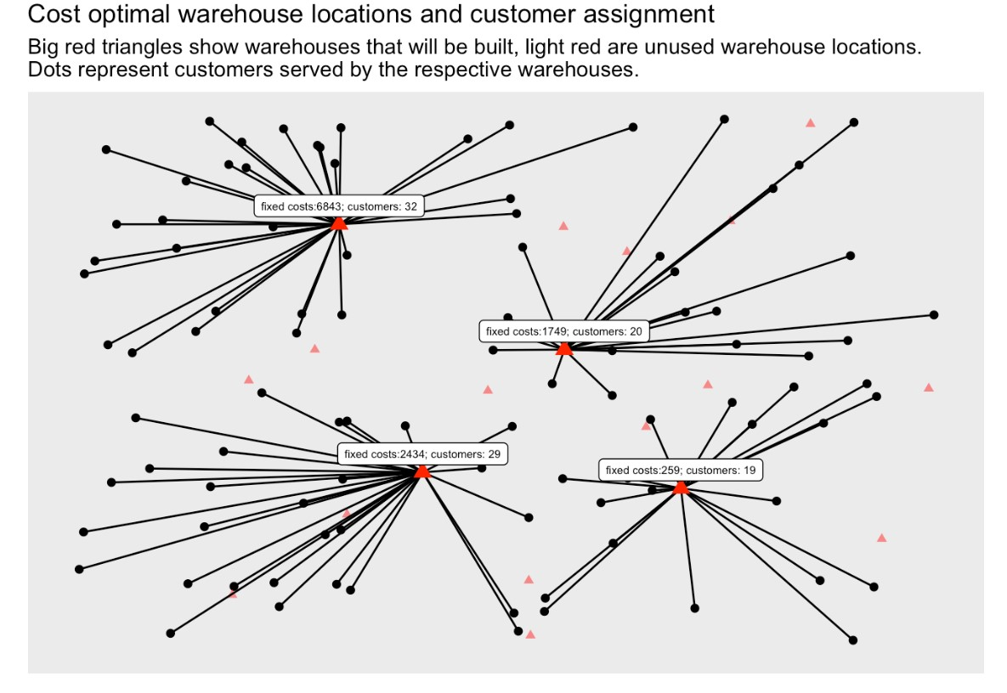
Problem Statement
Say a large supermarket chain needs to build warehouses but the locations of the warehouses have yet to be determined. Also opening many warehouses would be advantageous as this would reduce the average distance a vehicle has to drive from the warehouse to the customer, and hence reduce the delivery cost. However, opening a warehouse has a fixed cost associated with it.
By deciding which facility/warehouse to open and, for each customer, who serves it, determine the minimum cost solution that satisfies all customers while respecting the capacities of the facilities in CFL, in the hypothesis of each customer being served by a single facility.

Slide 7
Model Formulation Hypothesis
While doing model formulation we took this into consideration like, there are fixed costs for opening the plants and transportation costs to supply the commodity or the standard product-mix from potential location sites to clients.
The CFLP considers a situation in which the plants have a capacity expressed in units of demand and also assumes that each client can be served from different open plants.
If each customer served from single facility then its single source capacitated facility location (sscflp) problem & assumption is, transportation costs from facilities to markets are linear according to the quantity transported.

Slide 8
Objective Function
Minimizes the cost of assigning customers to open facilities and the cost of establishing such facilities.
Capacity constraints in CFLP (or the facility constraint), ensures that the customer demand served by a certain facility does not exceed its capacity.
Demand constraints (or the customer constraints), ensures that each customer is assigned to exactly one facility.
Assignments are made only to open facilities.
All decision variables are binary.

Slide 9
Given parameter for model:
n potential sites where a facility that provide a service could be installed: J = {1, .., n}
The fixed cost of opening each facility j: F = {f1, .., fn}
The capacity of each facility j (i.e. the maximum amount of service that can be delivered by the facility): S = {s1, .., sn}
m customers: I = {1, .., m}
The service demand of each customer i: D = {d1, .., dm}
The cost of allocating all the demand of customer i to facility j: c_ji for each (j=1,...,|J|), (i=1,...,|I|)
Development Environment:
Java Development Kit(JDK)
Dataset Used:
OR Library Instances-cap61
These data files are set OR-Library in Guastaroba G. and Speranza M.G. A Heuristic for BILP Problems: The Single Source Capacitated Facility Location Problem, currently under review in the European Journal of Operational Research.

Slide 10
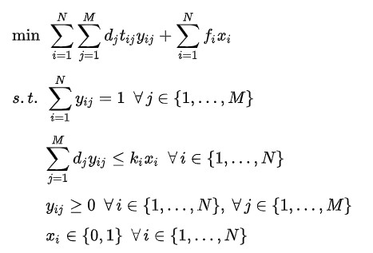
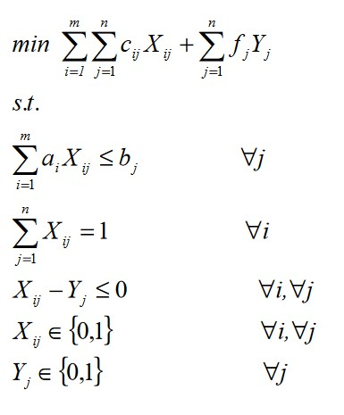
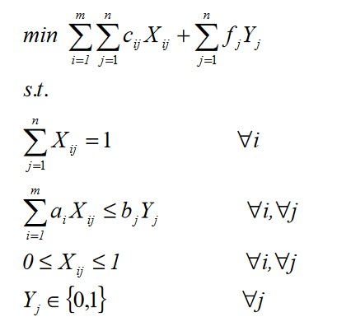
Objective Function while Model Formulation
CFLP
(with customer demand)
SSCFLP
CFLP

Slide 11
Implemented Algorithms
Constructed capacitated facility location model with help of three heuristic algorithms & compared results at last:
Greedy Algorithm
Local Search
Tabu Search

Slide 12
Greedy Algorithm
Makes the best optimal choice at each small stage with the goal of leading to optimal solution.
How algorithm works in our model ?
Step1: Calculates total service/transportation cost associated with each facility to all customers and choose that facility which has less total service cost.
Step2: Again it checks, the lower service cost associated with customer w.r.t. The chosen facility and extract the demand of that customer.
Step3: Now demand of that customer gets minused from capacity of chosen facility (Dataset predefined the capacity of individual facility).

Slide 13
Greedy Continued…
Step4: After exhaustion of capacity of chosen facility, next facility which has less total service cost get selected and Step2,3 repeated.
When each customer gets served from single facility, our greedy algorithm gets terminated.
Total cost = Transportation/Service cost associated with each customer w.r.t. Their assigned facility + Fixed cost of opening all chosen facilities.
Total cost - - - -> Optimum value.
Relative error is 39.2% w.r.t optimum total cost value through greedy.
Gives first rough solution and in coming algorithms we reduced this error.

Slide 14
Local Search
Algorithm starts from a candidate solution and then iteratively moves to a neighbour solution.
For 1st iteration, candidate solution is solution obtained from greedy method.
How algorithm works in our model ?
Step1: Selecting customer from opened facilities and swap to another facility whose capacity is available in such a way that after swap we get total service cost minimum than the candidate solution’s total service cost.

Slide 15
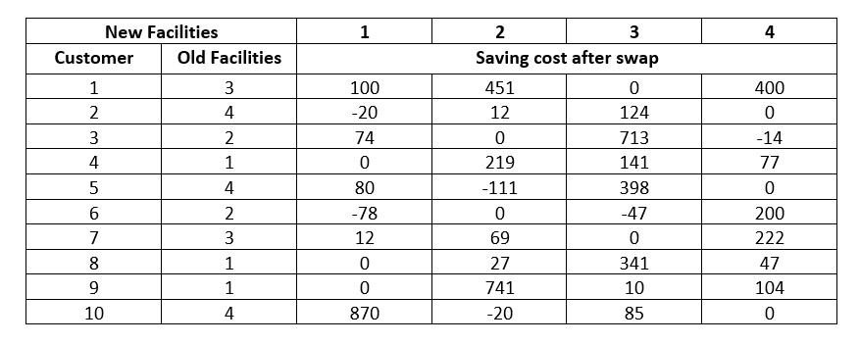
Step2: In iteration 2, iteration 1 is candidate solution, repeat step1 for upcoming iteration till that iteration where no feasible improvement possible i.e, algorithm not able to find any significant saving cost value where, saving cost=service cost before-service cost after.

Slide 16
Tabu Search
It works similar to local search, except that the recently swapped customers or involved facilities are not consider while building improvement graph.
In some cases, it accepts not profitable swaps to see if it can find better improvement in second moment.
In this way we can escape the attraction basin of the local optimum found previously by the local search with the aspiration to find better one.
How algorithm works in our model ?
Step1: Choose an previous solution by local search as candidate solution and create empty tabu list.
Step2: Selecting customer from opened facilities and swap to another facility whose capacity is available (Swap may or may not always profitable) and define aspirations.
Step3: Update the tabu list and the aspiration conditions for building the improvement graph.

Slide 17
Step4: Repeat the above steps until we met our stopping condition, which is number of iterations allowed in model.
Flowchart:
Initial solution
Create a candidate list of solutions
Evaluate solutions
Stopping conditions satisfied?
Update Tabu and aspiration conditions
No
Choose the best admissible solution
Yes
Final solution

Slide 18
Results
Approach | Relative Error | Total Cost
Greedy Algorithm | 39.2270% | 1298453.8
Local Search | 4.2215% | 971987.0
Tabu Search | 1.2011% | 943817.6
Optimum Value - 932615.8 (Pre-defined in dataset)

Slide 19
Conclusion
Among three algorithms greedy, local search and tabu search, the tabu algorithm i.e. meta-heuristic algorithm provides optimal results than the other two algorithms where this performance is measured on the basis of parameters such as total cost and relative error.
In output, warehouses are opened who serves the customers based on optimum total cost.

Slide 20
Thank You!

